Slide 1

ASSIGNMENT 2, GROUP 2 PROJECT: Developing a BI Dashboard Using Power BI and Open-Source Data
MAY-AUGUST SEMESTER 2025 MRDC 911: FUNDAMENTALS OF DATA SCIENCE AND COMPUTATIONAL INTELLIGENCE.
Group Assignment
MEMBERS:
Sila Ronoh
Dorothy Owuor
Isaac Nyasiri

Slide 2
Project Overview
Financial Risk and Credit Performance Dashboard
Project Overview: This Power BI dashboard analyzes a CRB-related financial dataset to assess borrower creditworthiness, loan performance, and default risk. The dataset includes over 20,000 records and 20+ features such as credit scores, loan amounts, repayment delays, and property area. The goal is to inform risk-based lending decisions, minimize non-performing loans (NPLs), and support data-driven loan strategies.

Slide 3
About the Dataset
This dataset was sourced from Kaggle, under the domain of financial risk and credit reporting. It simulates data from a Credit Reference Bureau (CRB)/financial institution and contains demographic and financial information on individuals, along with indicators of loan performance.
The dataset contains 20,000 records of loan applications with 23 features. It includes demographic details, financial metrics, loan terms, and risk indicators such as credit scores, default probabilities, and collateral values. This comprehensive dataset supports financial risk analysis and predictive modeling for loan defaults.
https://www.kaggle.com/datasets/jokimrodrigues/financial-risk-analysis-dataset?resource=download
Features: Loan_ID, Applicant_Age, Years_in_Employment, Marital Status, Dependents, Applicant_Income, Coapplicant_Income, Credit_Score, Existing_Debt, Loan_Amount, Loan_Term_Months, Interest_Rate, Collateral_Value, Employment_Type, Education_Level, Property_Area, Loan_Start_Date, Payment_Delays_6mo, Credit_Utilization_Ratio, Debt_to_Income_Ratio, Loan_End_Date, Probability_of_Default, Default_Status

Slide 4
Justification for Dataset
The dataset simulates real-world credit and loan data, relevant to banks, SACCOs, and microfinance institutions.
It includes detailed borrower information — demographics, income, credit scores, loan details, and repayment behavior.
Enables analysis of default risk, creditworthiness, and loan performance, which are critical for financial decision-making.
The clean, structured format is ideal for creating Power BI dashboards with KPIs, trends, and segmentation.
Supports practical use cases like risk-based lending, NPL reduction, and borrower profiling.
Offers a 360° view of borrower risk profiles.
Enables segmentation by demographics, income sources, and credit behavior.
Useful for identifying patterns that correlate with default risk and credit score health.

Slide 5
Business Context
In Kenya, financial institutions such as banks,DFIs, SACCOs, and digital lenders face increasing pressure to manage credit risk and reduce non-performing loans (NPLs). The rise of mobile lending and fintech has expanded access to credit, but also increased the need for accurate borrower risk profiling.
This project simulates a Credit Risk Analysis System for a Kenyan microfinance or digital lending firm. The aim is to help credit officers and decision-makers assess a borrower's ability and willingness to repay, using BI tools and historical data.

Slide 6
Stakeholders
Stakeholder | Role & Interest
Loan Officers | Use credit score and repayment insights to approve or reject loan applications
Risk Managers | Monitor portfolio risk, flag high-risk clients, and update lending policies
Branch Managers | Oversee loan performance at the local level and ensure target recovery rates
Executives/Directors | Make strategic decisions on lending models and risk exposure
Regulators (CBK, CRBs) | Interested in credit compliance, default trends, and borrower treatment
Fintech/Data Teams | Use insights to refine credit scoring models and borrower segmentation strategies

Slide 7
Key Data Elements
Demographic Information | Financial Metrics | Credit Performance
Applicant_Age | Applicant_Income | Credit_Score
Marital_Status | Coapplicant_Income | Loan_Amount
Dependents | Existing_Debt | Loan_Term_Months
Education_Level | Collateral_Value | Interest_Rate
Employment_Type | Debt_to_Income_Ratio | Payment_Delays_6mo
Property_Area |  | Credit_Utilization_Ratio
 |  | Probability_of_Default
 |  | Default_Status

Slide 8
Data Analysis – Key Insights
Key Objectives:
Identify high-risk borrower profiles using credit metrics
Minimize Non-Performing Loans (NPLs) through targeted risk analysis
Enable financial institutions to apply risk-based lending practices
Support segmentation of borrowers by credit behavior and demographics

Slide 9
Key Insights
Category | Insight | Implication
Demographic Patterns | Young borrowers (<25 years) have highest default rates | Indicates need for credit education and cautious underwriting
 | Married applicants show lower risk | Marital status may be used as a supporting risk factor
 | Rural borrowers show higher DTI and default risk | Suggests targeted risk controls by region
Financial Risk Indicators | High DTI (>40%) borrowers are 2× more likely to default | DTI should be a core variable in credit risk assessment
 | Low collateral value increases risk | Collateral coverage ratio should guide loan limits
 | No co-applicant income increases default risk | Encourage co-applicants or adjust risk pricing accordingly
Credit Behavior Trends | 2+ recent payment delays predict 4× higher default risk | Use as early warning trigger
 | Credit Utilization Ratio > 80% flags over-leveraging | Useful for borrower monitoring and alerts
 | Credit scores <600 dominate default group | Set credit score thresholds for product eligibility
Loan Characteristics | Long-term loans (>36 months) show higher default in business/self-employed borrowers | Consider shorter terms or stepped repayment plans
 | Higher interest rates linked to more defaults | Risk-based pricing must consider affordability
 | Loan disbursement shows seasonal trends, peaking in Q2 and Q4 | Plan capital allocation and marketing accordingly

Slide 10
KPIs Identified
KPI Name | Description
1. Default Rate | % of loans that have defaulted (Default_Status = 1)
2. Average Credit Score | Mean credit score across borrowers – measures portfolio quality
3. Loan Approval Rate | % of total applications approved (if applicable)
4. Debt-to-Income Ratio (DTI) | Average DTI across portfolio – indicates borrower affordability
5. Loan Disbursement Volume | Total value of loans disbursed in a time period
6. Average Loan Amount | Mean loan value issued – helps compare across segments or regions
7. Payment Delay Frequency | % of borrowers with 2+ delays in past 6 months
8. Credit Utilization Ratio | % of available credit used by borrower – indicates over-leverage
9. Probability of Default (PD) | Model-generated estimate of default risk per borrower
10. NPL Ratio by Region | % of non-performing loans by location (Urban, Semiurban, Rural)
11. Collateral Coverage Ratio | Collateral_Value / Loan_Amount – measures loan security
12. Portfolio at Risk (PAR 30/90) | % of outstanding balance with overdue payments beyond 30/90 days
13. Employment Risk Index | Default rate by employment type (Salaried, Self-employed, Business)
14. Credit Score Band Mix | Distribution of borrowers by credit score band (Poor, Average, Good, Excellent)
15. Recovery Rate | % of defaulted loan amounts recovered over a defined period

Slide 11
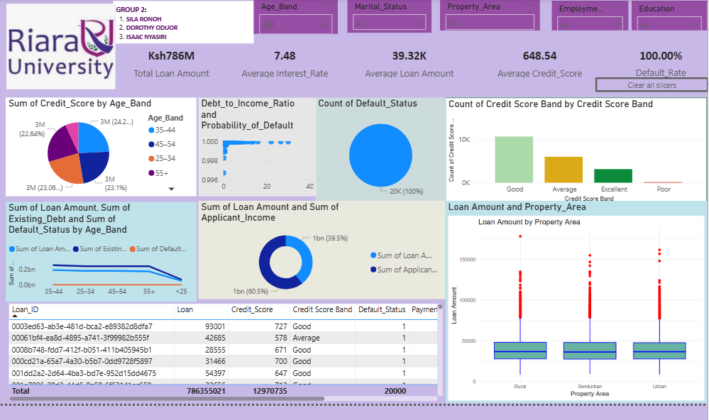
Power BI Dashboard – Overview

Slide 12
Power BI Dashboard – Overview
This Power BI dashboard analyzes a CRB-related financial dataset to assess borrower creditworthiness, loan performance, and default risk. The dataset includes over 20,000 records and 20+ features such as credit scores, loan amounts, repayment delays, and property area. The goal is to inform risk-based lending decisions, minimize non-performing loans (NPLs), and support data-driven loan strategies

Slide 13
Dashboard Features
Feature | Tool/Visualization | Purpose / Benefit
Slicers (Filters) | Filter panels | Filter by Age, Employment, Score Band, Region
Drill-through to Client Profile | Linked page view | Detailed assessment per applicant
Conditional Risk Alerts | Conditional formatting | Highlight PD > 80%, DTI > 40%, etc.
Loan Vintage Risk Curve | Line or cohort chart | Analyze performance by loan issue month
Export Options | Button / menu | Export filtered reports to PDF or Excel

Slide 14
Dashboard Features
Feature | Visualization Type | Purpose / Benefit
KPI Cards | Card tiles | Quick snapshot: Total Loans, Default Rate, Avg. Credit Score, DTI
Loan Disbursement Trend | Line chart | Shows loan volume over time (monthly/quarterly trend)
Loan Status Breakdown | Pie or bar chart | Compare performing vs. defaulted loans
Portfolio Health Score | Gauge or composite index | Composite score reflecting portfolio risk health
Borrower Segmentation | Stacked bar chart | Segment by age, education, employment, property area
Average Loan by Property Area | Bar chart | Compare disbursement across urban, semiurban, and rural zones
Income Distribution | Histogram | Visualize spread of applicant income levels
Applicant Risk Matrix | Table | View individual borrower metrics (Loan ID, Score, Income, Default)
Credit Score Distribution | Histogram | Group borrowers into risk bands
Credit Score vs. DTI | Scatter plot | Identify high-risk clusters (low score, high DTI)
Key Influencers (AI Visual) | AI-driven explainer chart | Pinpoint top drivers of default
Probability of Default Table | Ranked table | Identify top-risk customers for early action
Default Rate by Region | Map or filled region chart | Spot regional NPL hotspots
Loan Default by Property Area | Column chart | Compare default across regions
Branch Risk Summary | Bar or matrix chart | Score and performance by outlet or region

Slide 15
Dashboard Visualizations Overview
Visualization | Purpose | Expected Insight
Bar Chart: Loan Amount by Property Area | Compare average loans across regions | Urban = higher loans; rural = higher default risk
Map Visualization: Default by Region | Show default intensity by location | Rural zones may show higher NPLs
Stacked Column: Education vs Defaults | View default behavior by education level | Non-graduates may default more
Line Chart: Loan Disbursement Trend | Track loan volume over time | Seasonal or economic-cycle impacts
KPI Cards: Portfolio Health | Quick overview of loan book metrics | Flag if average PD or defaults are rising
Scatter Plot: Credit Score vs DTI | Examine default clustering by financial risk | High DTI + low score = higher default risk
Histogram: Income Distribution | View borrower income ranges | Target segments can be profiled
Key Influencers Visual | Rank drivers of default risk | Credit score, employment type most influential
Matrix Table: Applicant Summary | Tabular drill-down per applicant | Enables case-by-case analysis or auditing
Box Plot: Loan by Employment Type | Compare loan spread/outliers by job type | Business loans more varied than salaried

Slide 16
User Manual Summary
Section | Description
Access & Login | Users access via secure login to Power BI Service or Desktop. Role-based access controls are enforced.
Home Page Overview | Displays headline KPIs: Total Loans, Default Rate, Avg. Credit Score, Avg. DTI. Navigation bar links to dashboard sections.
Dashboard Pages | The dashboard is organized into multiple pages: Portfolio Overview, Segmentation, Risk Analysis, and Geographic Insights.
Filters & Slicers | Slicers for Age, Employment Type, Region, Loan Term, Credit Score Band. Filters dynamically update all visuals.
Drill-Throughs | Click on chart data points (e.g., branch or region) to drill through to borrower-level detail (Loan ID, Score, Status).
Visual Explanations | Hover tooltips provide descriptions. Visuals include: pie charts, bar charts, scatter plots, maps, KPIs, line charts.
Exporting Reports | Users can export views to PDF or Excel for offline use. Slicers affect exported data.
Risk Alerts & Flags | Conditional formatting highlights risk (e.g., PD > 80%, Utilization > 90%). Used for proactive monitoring.
Refresh Schedule | Dashboard is refreshed daily from the data warehouse (or CRB feed), ensuring timely risk updates.
Support | Questions or errors can be reported to the BI support team via email or helpdesk system.

Slide 17
Key Takeaways
Insight | Implication / Recommended Action
High default rates in rural areas | Indicates geographic credit risk—review risk pricing or lending thresholds for rural applicants
Borrowers with low credit scores (<600) dominate defaults | Validate and enforce minimum credit score cutoffs for new lending
Self-employed borrowers have higher delinquency | Strengthen vetting and repayment structures for informal or business-income applicants
Graduates show lower default rates | Use education level as a positive credit scoring variable
High Credit Utilization Ratio (>80%) linked to defaults | Monitor utilization and set early warning alerts to manage repayment stress
Loan disbursements spike in Q2 and Q4 | Plan liquidity and risk exposure cycles around seasonal lending trends
Debt-to-Income Ratio (DTI) > 40% increases default probability | Use DTI thresholds as part of credit decision rules
Key influencers identified: Credit Score, DTI, Payment Delays | Focus on these predictors in automated risk scoring and underwriting models
Segment-based risk varies across education, age, and employment | Enables tailored products, pricing, and risk controls by demographic segment
Portfolio health indicators signal rising PD in specific cohorts | Prompt deeper risk reviews and provisioning for flagged customer clusters

Slide 18
GitHub Repository

Slide 19
Live Demo

Slide 20


